Slide 1

Finvault
Group members
Youssef Hossam Eldein Mostafa
Mahmoud Ahmed Mohamed Ahmed Sultan
Mohamed Ahmed Mohamed Taha
Kareem Mahmoud alsabagh
Mahmoud Mohamed Waheed Mohamed
Mark Mourad Millad Ryad

Slide 2
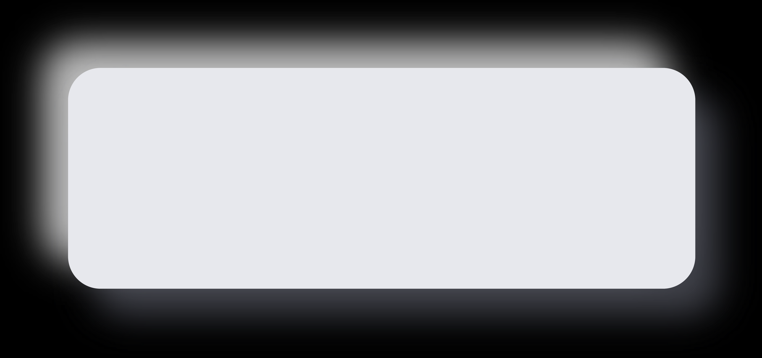
Finvault
01.
02.
The test plan
Manual testing
03.
04.
Database testing
API testing
The project parts
05.
The automation
testing

Slide 3
Our test plan
This test plan outlines the QA strategy for the LambdaTest E-Commerce Playground, a simulated online shopping platform. The primary goals are to verify core shopping functionalities, ensure UI responsiveness, validate inputs, and check cross-browser compatibility
Testing will focus on functional workflows like registration, login, search, cart management, checkout, and account updates. Out-of-scope areas include database testing, real payment transactions, and security/penetration testing
PROJECT OVERVIEW
SCOPE
The team will use black-box techniques (such as boundary value analysis and equivalence partitioning) for functional and compatibility testing. The test environment covers Windows 10/11 using Chrome, Firefox, and Edge, utilizing tools like Selenium, Postman, and Jira
Environment
Execution Criteria
Entry requires an accessible site and ready environment, while exit requires all tests executed and critical bugs resolved. The 15-day schedule produces deliverables like bug reports and is executed by a six-member team

Slide 4
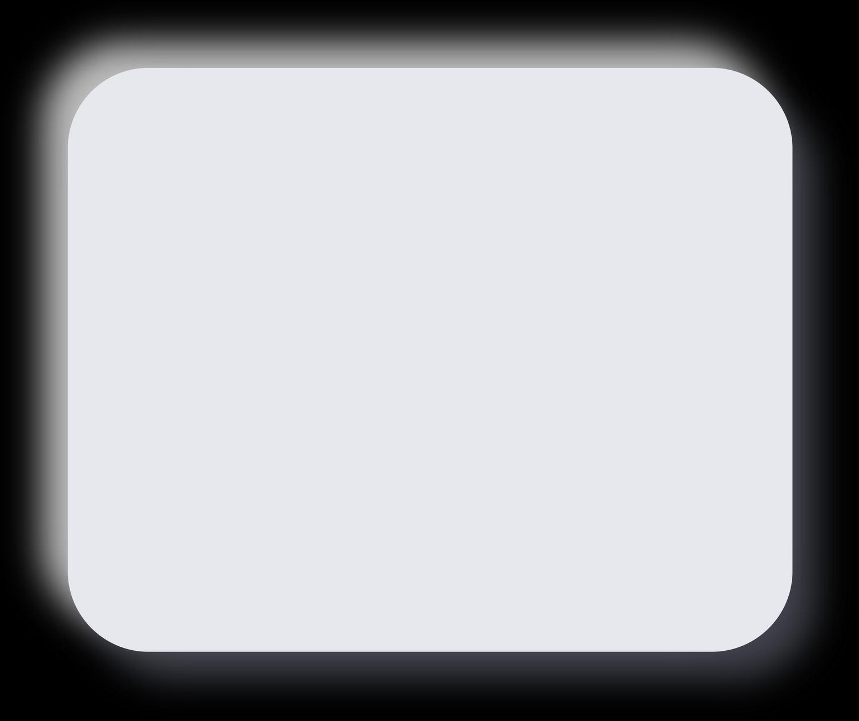
Strategic Initiatives
01
02
03
04
Manual
Testing
API
Testing
Database
Testing
Automation
youssef : Staff
mark : Address
mohamed : Film _ actor+language
sultan : Film
kareem : Store + category
mahmoud : Payment
Same as manual testing
youssef : reg & login
mark : home & navbar
mohamed : blog
sultan : AddOns 1 + search
kareem : AddOns 2
mahmoud : categories
1-2-3 mark
4-5 domty
6-7 mohamed
8-9 -10 mahmoud
11-12 kareem
13-14 sultan
ecommerce-playground.lambdatest.io
automationexercise.com
Sakila
https://downloads.mysql.com/docs/sakila-db.zip
ecommerce-playground.lambdatest.io

Slide 5
Thanks for your time

